Slide 1

Department of Computer Science and Engineering Machine Learning With Python Tittle: Credit Card Fraud Detection
Vivekanandha College of Engineering for Women(Autonomous)
1

Slide 2


Machine Learning With Python Tittle: Credit Card Fraud Detection
Team Members:
Pandi kavya[19101074]
Thathireddy Pushpalatha[19101113]
Yegireddy Deekshitha[19101124]
Guide Details:
Dr. R. Nithya
Associate professor
2

Slide 3
CONTENTS
Abstract
Introduction
Problem Statement
Existing System
Drawbacks
Proposed system
System Model
Modules Collection
1. Load Dataset
2. Data Pre-Processing
3. Accuracy Result
System specification
Conclusion
Future Enhancement
References
3

Slide 4
ABSTRACT
Credit card fraud is a growing problem that affects both financial institutions and customers worldwide.
Despite the integration of chip cards and existing protection systems, new types of fraud continue to emerge, making it difficult to track and create rules in time. To address this problem, artificial intelligence techniques such as support vector machines (SVMs) have been applied to develop credit card fraud detection systems.
This paper proposes a credit card fraud detection system using SVMs and describes the various modules necessary for the system's functioning.
These modules include data preprocessing, feature engineering, SVM model training, real-time fraud detection, model evaluation, and reporting.
Additionally, we describe the importance of input data and feature extraction, highlighting their critical roles in the credit card fraud detection process.
The proposed system's advantages include its ability to detect fraudulent transactions accurately, its efficiency in processing real-time data, and its potential to reduce the number of employees required to track and prevent fraud. Overall, this paper demonstrates the effectiveness of using SVMs and artificial intelligence techniques to develop credit card fraud detection systems, which have significant potential in enhancing financial security for institutions and customers..
4

Slide 5
INTRODUCTION
The use of credit cards is prevalent in modern day society. But it is obvious that the number of credit car fraud cases is constantly increasing in spite of the chip cards worldwide integration and existing protection systems. This is why the problem of fraud detection is very important now.
In this work the general description of the developed fraud detection system and comparisons between models based on using of artificial intelligence are given. In the last section of this work the results of evaluative testing and corresponding conclusions are considered.
The use of credit cards is prevalent in modern day society. But as in other related fields, financial fraud is also occurring in spite of the chip cards worldwide integration and existing protection systems.
This is why most software developers are trying to improve existing methods of fraud detection in processing systems. The majority of such methods are rules based models.
Such models allow bank employees to create the rules describing transactions that are suspicious. But the number of transactions per day is large and new types of the fraud appear quickly.
5

Slide 6
PROBLEM STATEMENT
The Credit Card Fraud Detection Problem includes modeling past credit card transactions with the knowledge of the ones that turned out to be a fraud.
This model is then used to identify whether a new transaction is fraudulent or not.
Here is to detect 100% of the fraudulent transactions while minimizing the incorrect fraud classifications.
6

Slide 7
EXISTING SYSTEM
People can use credit cards for online transactions as it provides an efficient and easy-to-use facility. With the increase in usage of credit cards, the capacity of credit card misuse has also enhanced.
Credit card frauds cause significant financial losses for both credit card holders and financial companies.
In this research study, the main aim is to detect such frauds, including the accessibility of public data, high-class imbalance data, the changes in fraud nature, and high rates of false alarm.
The relevant literature presents many machines learning based approaches for credit card detection, such as Extreme Learning Method, Decision Tree, Random Forest, Support Vector Machine, Logistic Regression and XG Boost.
However, due to low accuracy, there is still a need to apply state of the art deep learning algorithms to reduce fraud losses. The main focus has been to apply the recent development of deep learning algorithms for this purpose.
7

Slide 8
DRAWBACKS
Less accuracy.
Poor Prediction Result
Cannot support dynamic Datasets.
Lack in time performance.
8

Slide 9
PROPOSED SYSTEM
A proposed system for credit card fraud detection using Support Vector Machines (SVMs) could involve several key steps. First, transaction data would need to be collected from credit card companies or financial institutions, and then preprocessed by removing any unnecessary columns and encoding categorical features.
Next, the data would be split into training and testing sets, and an SVM model would be trained on the training data using a suitable kernel function (such as linear, polynomial, or radial basis function). The hyperparameters of the SVM model, such as the regularization parameter C and kernel function parameters, would be tuned to optimize its performance on the testing set.
Once the model has been trained, it can be deployed to detect fraud in real-time credit card transactions. The model would analyze each transaction and predict whether it is fraudulent or not based on the learned patterns in the training data.
The performance of the model would be evaluated using metrics such as accuracy, precision, recall, and F1-score. Comparisons could also be made between different models based on the use of SVMs or other machine learning algorithms to determine the most effective approach for detecting fraud.
9

Slide 10
SYSTEM MODEL
USER
BANK
CREDIT CARD DATASET
CD LAYER
APPLICATION FORMS
TRANSACTION QUERY
SD LAYER
THRESHOLD AMOUNT CALCULATION
SVM FRUAD APPLICATION DETECTED
CHALLENGE SECURITY QUESTION
IF TRANSCATION AMOUNT > THRESHOLD AMOUNT
TRANSCATION AUTHENTICATED OR DECLINED
USER / FRAUDSTER WANTS TO PERFORME TRANSACTION
10

Slide 11
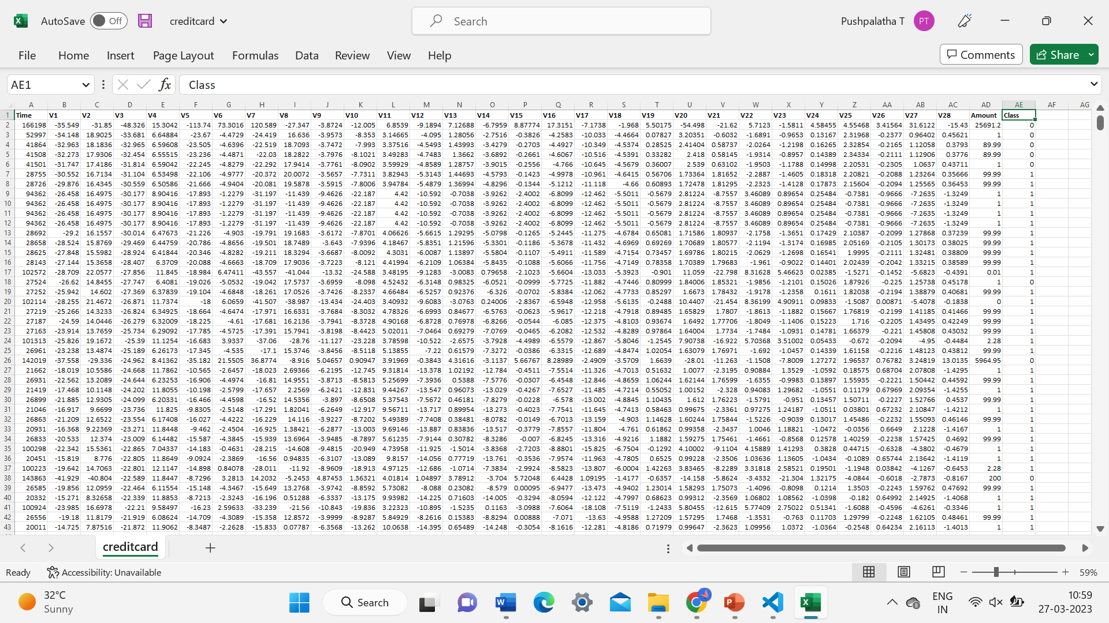
MODULES COLLECTION
1.Load Dataset
11

Slide 12
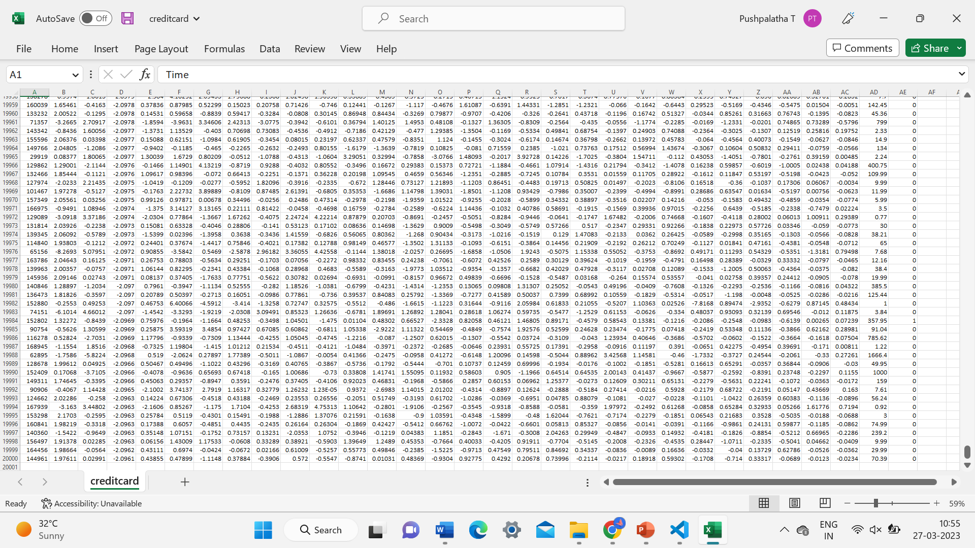
12

Slide 13
2.Data Pre-Processing
Data preprocessing is the process of cleaning, transforming, and organizing raw data before it is used for analysis or modeling. It involves a series of steps that are performed to ensure that the data is accurate, complete, consistent, and relevant.
This involves removing or correcting any errors or inconsistencies in the data, such as missing values, duplicates, or incorrect values. This involves converting the data into a suitable format for analysis or modeling.
This may include scaling, normalization, or encoding categorical variables.This involves reducing the amount of data to be analyzed by selecting relevant features or samples, or by summarizing the data through techniques such as clustering or principal component analysis.
This involves combining data from multiple sources into a single dataset for analysis.
13

Slide 14

3. Accuracy Result
14

Slide 15
RESULT GRAPH
15

Slide 16
SYSTEM SPECIFICATION
HARDWARE REQUIRMENTS:
Processor : i5 Processor.
Ram : 8 GB RAM
Hard Disk : 1 TB
Keyboard : 105keys
Mouse : LG Optical Mouse
SOFTWARE REQUIREMENTS:
Operating System : Windows 10
Front end : JUPITER NOTEBOOK
CODING LANGUAGE : PYHTON
16

Slide 17
CONCLUSION
In conclusion, credit card fraud detection using SVMs is an effective way to combat the growing problem of fraudulent transactions.
SVMs are powerful machine learning algorithms that can learn patterns in the data and make accurate predictions about new transactions. By identifying relevant features in the transaction data and creating new features to improve the accuracy of the model, SVMs can detect fraudulent transactions with high accuracy.
The SVM classification process involves data preparation, feature extraction, model training, and prediction, all of which work together to detect fraudulent transactions.
The SVM model's accuracy is evaluated using testing data, and the model can be fine-tuned to achieve better accuracy.Credit card fraud is a serious problem that affects both individuals and financial institutions.
With the increasing prevalence of credit card fraud, it is essential to use sophisticated tools like SVMs to detect fraudulent transactions accurately. By using SVMs for credit card fraud detection, financial institutions can protect their customers' assets and prevent financial losses due to fraudulent activities.
17

Slide 18
FUTURE ENHANCEMENT
To further improve credit card fraud detection using SVMs, future research can explore several areas. One potential avenue for enhancement is to incorporate more advanced techniques for feature extraction, such as deep learning algorithms like convolutional neural networks (CNNs) or recurrent neural networks (RNNs).
These techniques can automatically learn relevant features from raw data and may improve the accuracy of the model.Another possible area of improvement is to use ensemble methods such as random forests or gradient boosting to combine multiple SVM models and improve the overall accuracy.
These techniques can also help to address the issue of imbalanced data sets, where fraudulent transactions are rare compared to legitimate transactions.Additionally, integrating real-time monitoring and alerts for suspicious transactions can further improve fraud prevention.
This would involve continuously monitoring transaction data and using predictive models to identify potentially fraudulent transactions in real-time, triggering alerts to fraud investigators or blocking transactions if necessary.
Overall, these future enhancements can help to make credit card fraud detection using SVMs even more accurate and efficient, ultimately helping to protect financial institutions and their customers from fraudulent activities.
18

Slide 19
REFERENCES
Y. Abakarim, M. Lahby, and A. Attioui, ‘‘An efficient real time model for credit card fraud detection based on deep learning,’’ in Proc. 12th Int. Conf. Intell. Systems: Theories Appl., Oct. 2020, pp. 1–7, doi: 10.1145/3289402.3289530.
[2] H. Abdi and L. J. Williams, ‘‘Principal component analysis,’’ Wiley Interdiscipl. Rev., Comput. Statist., vol. 2, no. 4, pp. 433–459, Jul. 2020, doi: 10.1002/wics.101.
[3] V. Arora, R. S. Leekha, K. Lee, and A. Kataria, ‘‘Facilitating user authorization from imbalanced data logs of credit cards using artificial intelligence,’’ Mobile Inf. Syst., vol. 2020, pp. 1–13, Oct. 2020, doi: 10.1155/2020/8885269.
[4] A. O. Balogun, S. Basri, S. J. Abdulkadir, and A. S. Hashim, ‘‘Performance analysis of feature selection methods in software defect prediction: A search method approach,’’ Appl. Sci., vol. 9, no. 13, p. 2764, Jul. 2021, doi: 10.3390/app9132764.
[5] B. Bandaranayake, ‘‘Fraud and corruption control at education system level: A case study of the Victorian department of education and early childhood development in Australia,’’ J. Cases Educ. Leadership, vol. 17, no. 4, pp. 34–53, Dec. 2021, doi: 10.1177/1555458914549669.
19

